Slide 1
INTRODUCTION TO RASPBERRY Pi
Exploring the Versatile Mini Computer
By Purushottam Mahajan SE Div A Roll No - 74

Slide 2
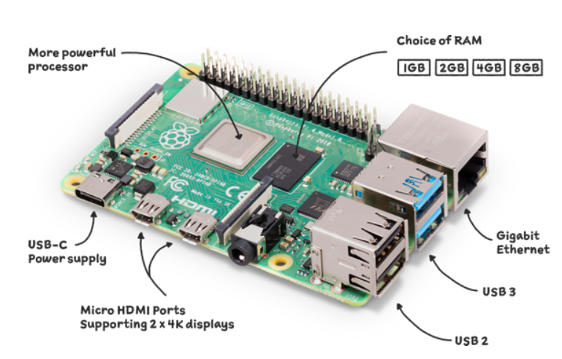
What is Raspberry Pi
Raspberry Pi is a small, affordable, and versatile computer developed by the Raspberry Pi Foundation, a UK-based charity organization. It is designed to promote computer science education and enable experimentation in programming and electronics. Raspberry Pi boards are single-board computers (SBCs) that feature all the essential components of a traditional computer, including a processor, memory, input/output (I/O) ports, and connectivity options, packed into a credit card-sized form factor.

Slide 3
History of Raspberry Pi
The history of Raspberry Pi dates back to 2006 when a group of academics and computer scientists, including Eben Upton, Rob Mullins, Jack Lang, Alan Mycroft, Pete Lomas, and David Braben, noticed a decline in computer science skills among applicants to the University of Cambridge. They attributed this decline to the lack of affordable, programmable computers for children.
In response to this concern, the group founded the Raspberry Pi Foundation in 2008 with the goal of creating a low-cost computer that would stimulate interest in programming among young people. The foundation aimed to develop a device that would be accessible to students, educators, and hobbyists and would promote computer science education worldwide.

Slide 4
Components of Raspberry Pi
1. System-on-Chip (SoC): The central processing unit (CPU), graphics processing unit (GPU), memory controller, and other essential components are integrated into a single chip. The SoC serves as the main processing unit of the Raspberry Pi.
2. Memory (RAM): Raspberry Pi boards include onboard memory (RAM) for running applications, storing temporary data, and buffering I/O operations.
3. GPIO (General Purpose Input/Output) Pins: These pins allow users to connect external components, such as sensors, LEDs, motors, and displays, for interfacing with the physical world. GPIO pins can be programmed and controlled using software to interact with external devices and perform various tasks.
4. USB Ports: Raspberry Pi boards feature USB ports for connecting peripherals, such as keyboards, mice, storage devices, Wi-Fi adapters, and other USB-enabled devices. USB ports provide expansion capabilities, allowing users to connect external devices for input, output, and data storage.

Slide 5
Components of Raspberry Pi
5. HDMI Port Raspberry Pi boards include an HDMI (High-Definition Multimedia Interface) port for connecting to displays, monitors, and TVs for video output. HDMI ports support high-definition (HD) video output, allowing users to use Raspberry Pi for multimedia applications, such as media playback and digital signage.
6. Ethernet Port : Some Raspberry Pi models include an Ethernet port for wired network connectivity, enabling internet access and communication with other devices on the local network.
7. MicroSD Card Slot: Raspberry Pi boards use microSD cards as the primary storage medium for the operating system, applications, and data. Users can install various operating systems (such as Raspberry Pi OS, Ubuntu, and others) on the microSD card to customize the functionality of Raspberry Pi for different applications.
8. Camera and Display Ports : Some Raspberry Pi models include camera and display ports for connecting camera modules and displays, respectively. These ports enable users to capture images and videos using camera modules and connect displays for visual output in applications such as photography, video recording, and digital signage.

Slide 6
Operating Systems for Raspberry Pi
Raspberry Pi OS (formerly Raspbian):
Raspberry Pi OS is the official operating system for Raspberry Pi, based on the Debian Linux distribution.
It is suitable for general-purpose computing, programming, web browsing, media playback, and educational purposes.
Ubuntu
Ubuntu is a popular Linux distribution that is available for Raspberry Pi.
It is suitable for general-purpose computing, software development, server hosting, and multimedia applications.
Debian
Debian is a stable and versatile Linux distribution that is compatible with Raspberry Pi.
Debian for Raspberry Pi provides access to a vast repository of software packages and libraries, making it suitable for a wide range of applications, including desktop computing, server hosting, and software development.

Slide 7
Programming Languages For Raspberry Pi
Python:
Python is the most popular programming language for Raspberry Pi due to its simplicity, versatility, and extensive libraries. Python libraries such as RPi.GPIO and GPIO Zero provide easy-to-use interfaces for controlling GPIO pins and interfacing with external hardware.
C/C++:
C/C++ programming languages are commonly used for low-level programming on Raspberry Pi, especially when performance and efficiency are critical. Libraries such as WiringPi and pigpio provide C/C++ APIs for controlling GPIO pins and accessing hardware features on Raspberry Pi.
Java:
Java is another programming language that can be used for programming Raspberry Pi, thanks to its cross-platform compatibility and extensive ecosystem of libraries. Libraries such as Pi4J provide Java APIs for controlling GPIO pins and interacting with hardware peripherals on Raspberry Pi.
JavaScript:
JavaScript can be used for programming Raspberry Pi using Node.js, a JavaScript runtime environment for server-side and IoT applications. Libraries such as rpio and onoff provide Node.js bindings for controlling GPIO pins and accessing hardware features on Raspberry Pi.

Slide 8
Advantages and Limitations
Advantages of using Raspberry Pi:
Low cost
Versatility
Community support
Educational resources
Limitations of Raspberry Pi:
Processing power limitations
Limited RAM
Lack of real-time capabilities
Compatibility issues with certain peripherals

Slide 9
Applications of Raspberry Pi
Education: Raspberry Pi is widely used in educational settings to teach computer science, programming, and electronics.
DIY Projects: Raspberry Pi is popular among hobbyists and makers for DIY projects. It can be used to create home automation systems, media centers, retro gaming consoles, weather stations, and more.
Internet of Things (IoT): Raspberry Pi is used in IoT projects to collect, process, and analyze data from sensors and devices.
Media Center: Raspberry Pi can be turned into a media center using software like Kodi or Plex.
Robotics: Raspberry Pi is widely used in robotics projects for controlling robots and drones. Its GPIO pins, along with motor controllers and sensors, allow users to build robots for various applications.

Slide 10
Thank You!

